Slide 1

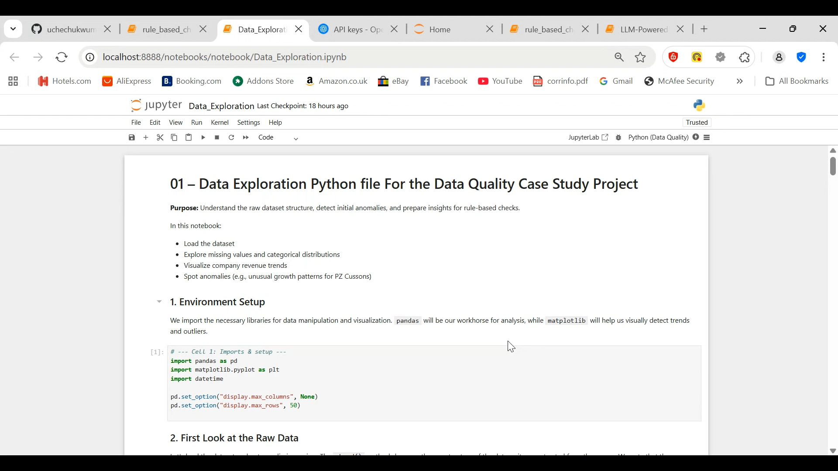
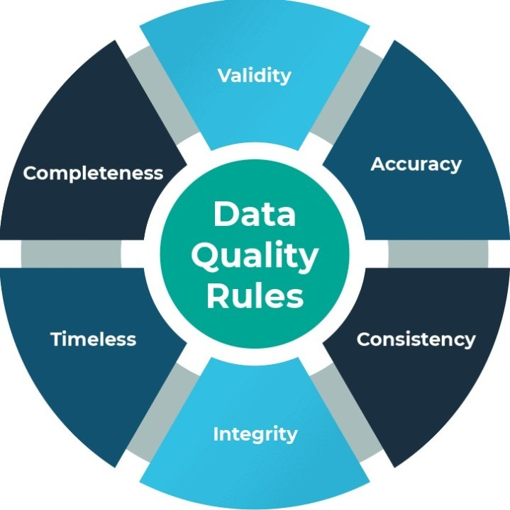

Data Quality Assurance Pipeline: Automated Analysis & Reporting
“Ensuring accurate, consistent, and actionable company data with AI-assisted validation”
Presented By:
Uchechukwu Obi
[Working Student – Statista Data Quality Team]
Date: 11th September 2025 — Internal Project Presentation

Slide 2



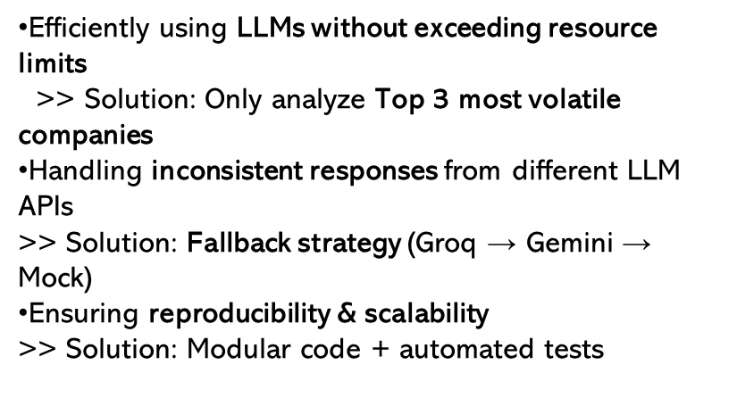


The Challenge: Ensuring Accurate & Consistent Financial Data
Companies rely on financial datasets for reporting and strategic decisions, but inconsistencies and missing values often lead to delays, errors, and unreliable insights.
Key Pain Points of input Data:
Manual verification of fiscal data is time-consuming.
Standardize missing values and fiscal period formats is required
Reporting lacks standardization, making insights hard to trust.
Project Objectives:
✅ Automate data quality checks on financial datasets. ✅ Standardize missing values and fiscal period formats. ✅ Leverage AI (LLM) to provide contextual insights and peer comparisons, using a multi-provider fallback: Groq API, then Gemini API, and finally a mock fallback to ensure consistent outputs. ✅ Generate unified outputs (dashboards and Excel reports) for faster, more reliable decision-making.
Tagline: A Multi-Layered Defense Strategy
Data Ingestion
Rule-Based Engine
(Standardization, Validation)
AI Analysis Layer
(LLM for Anomalies)
Trusted Output
+ Quality Reports
Insights
Presentation Title
Note ! - I Applied LLM-based analysis selectively to the top 3 most volatile companies for efficient resource management.

Slide 3

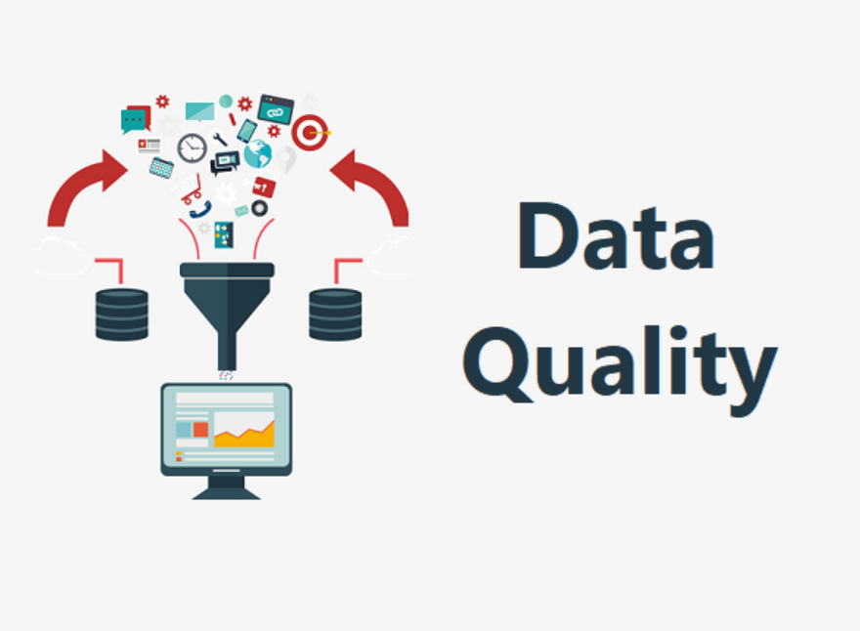
Quality Measures & Rationale
🔹 Implemented Quality Measures
Measure | Description
Date Format Correction | Ensures fiscal period is standardized to DD-MMM format for consistency
Missing Value Imputation | Infers missing “revenue_unit” based on country context
Company Name Standardization | Converts names to uppercase for uniformity across records - Entries (Rows) with missing “Company_name” is colored in red
Data Type Validation | Checks if critical columns match expected types (e.g., int, float)
Revenue Volatility Detection | Flags unusual YoY changes using a configurable threshold
🔹 Why These Were Chosen
- Directly address common extraction errors (formatting, missing values, type mismatches)
- Enable automated correction and flagging
- Lay the foundation for deeper semantic checks via LLM
🔹 Other Measures Considered
Timeliness: Is the data recent enough?
Referential Integrity: Are foreign keys consistent?
Duplication: Are there repeated records?
Outlier Detection: Beyond volatility, using statistical methods

Slide 4
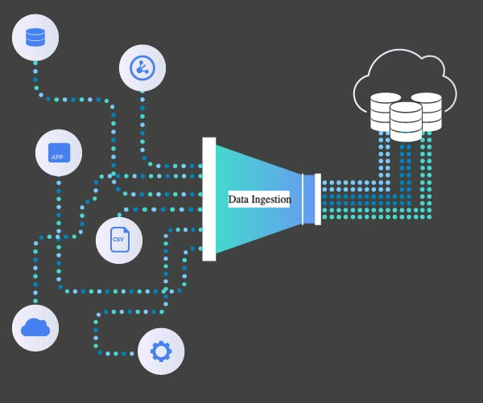









Approach: From Raw Data to Insights
I approached this case study as if I were solving a real-world data reliability challenge in a production environment.
Data Ingestion
Data Preparation
Rule-Based Checks
LLM-Powered Analysis
Reporting
Load raw Excel/CSV files.
Standardize fiscal_period_end, fix missing revenue units, clean formats.
Apply business rules (volatility detection, missing values, validity checks).
Use AI to interpret trends, detect anomalies, and provide peer insights.
Generate Excel outputs, dashboards, and summary reports.
Project execution Style
Preliminary work was done using three Jupyter notebooks, each handling a different aspect of the project.
The src project folder contains Python scripts packaged for production-grade execution.
Testing and reporting, along with all output files, are organized and saved within the project folder.

Slide 5
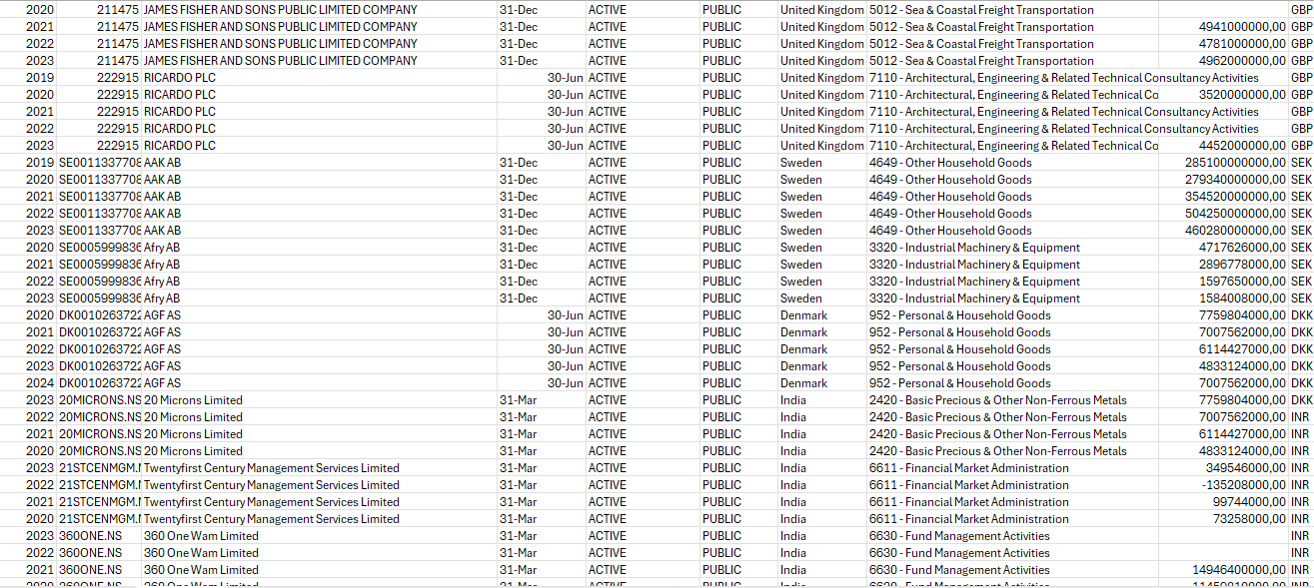
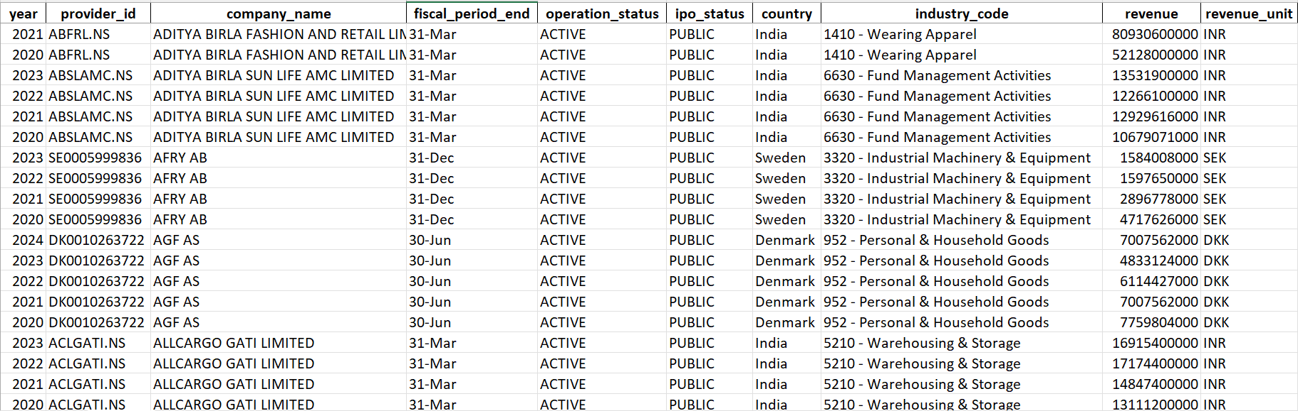
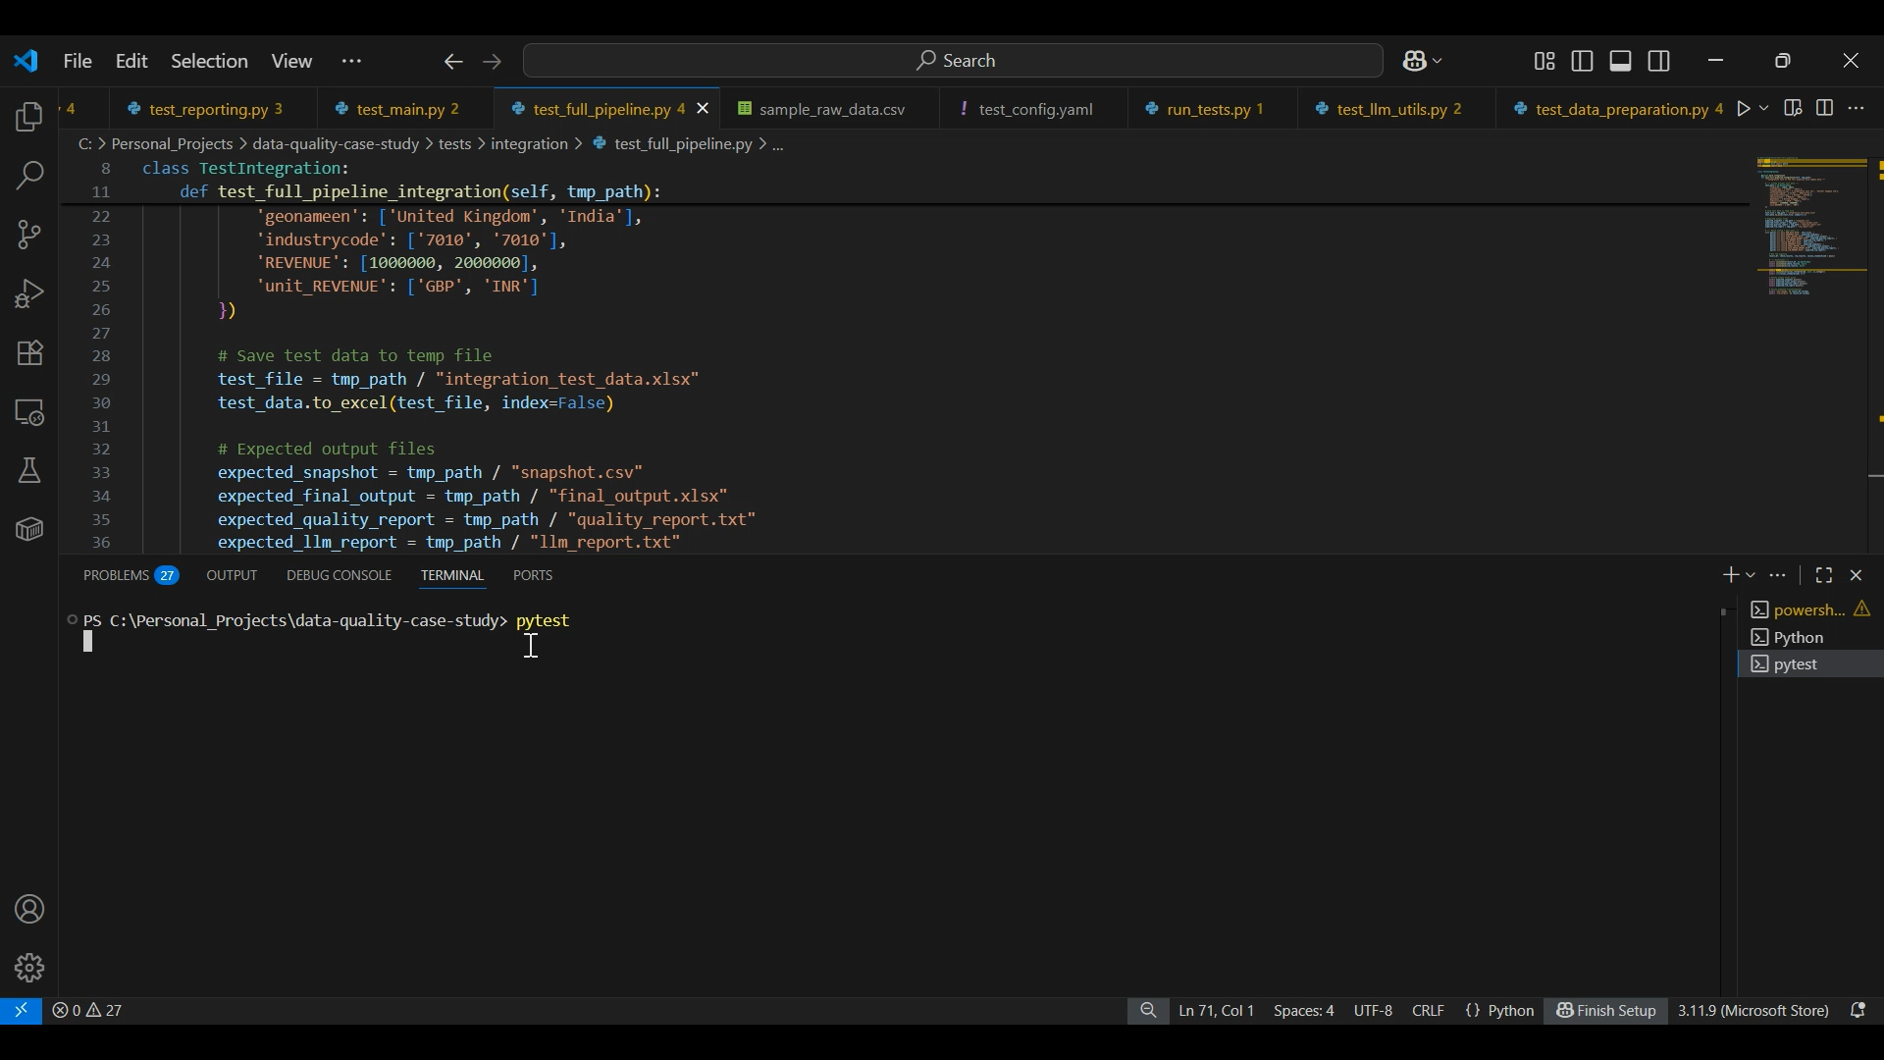
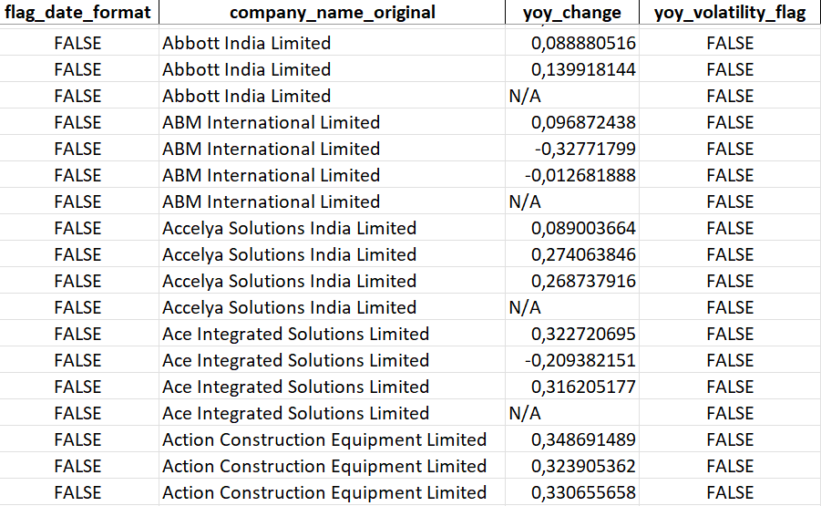
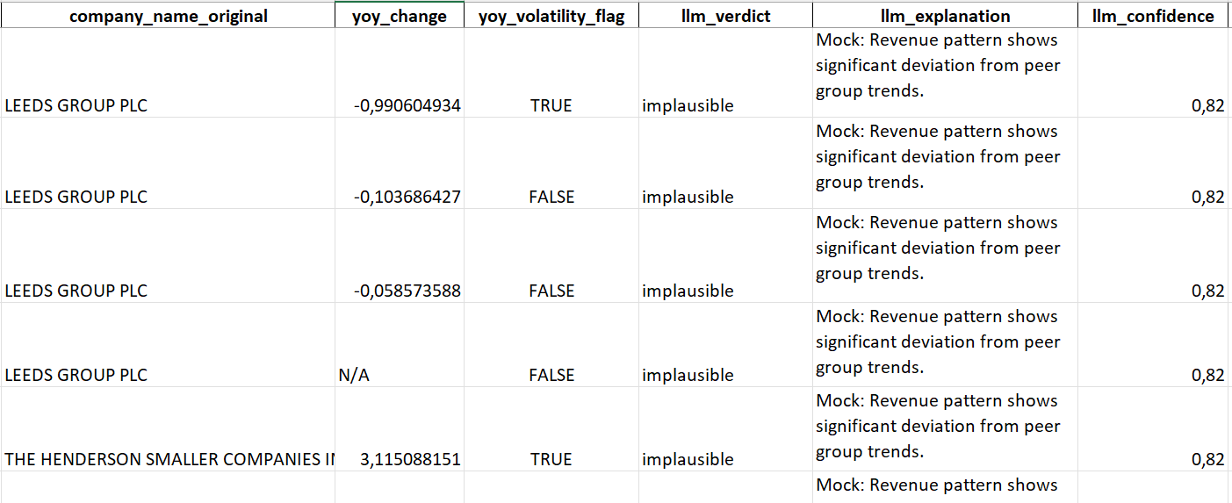
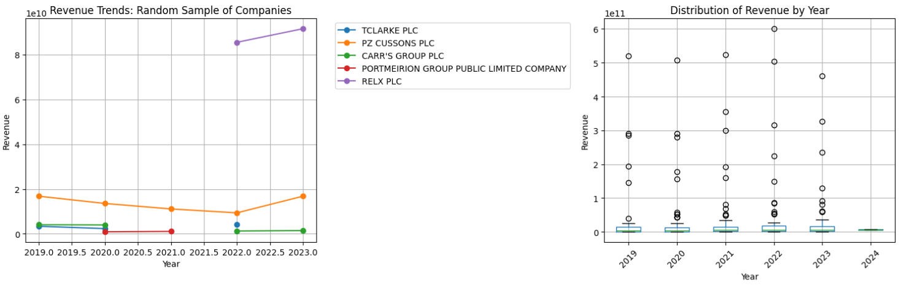
Deliverables & Key Insights
BEFORE : INPUT DATASET
AFTER : OUTPUT DATASET
Non-uniform date format, missing company names, revenue, revenue_units
Cleaned & Standardized Data – Fiscal periods corrected, missing revenue units inferred, “N/A” for missing data.
🚫
RAW DATA – NO Rule-Based Checks Implemented
Rule-Based Checks – Detected anomalies (e.g., YoY volatility, missing values).
🚫
RAW DATA – NO LLM-Powered Insights
LLM-Powered Insights – AI provided explanations & peer context for company performance.

Slide 6


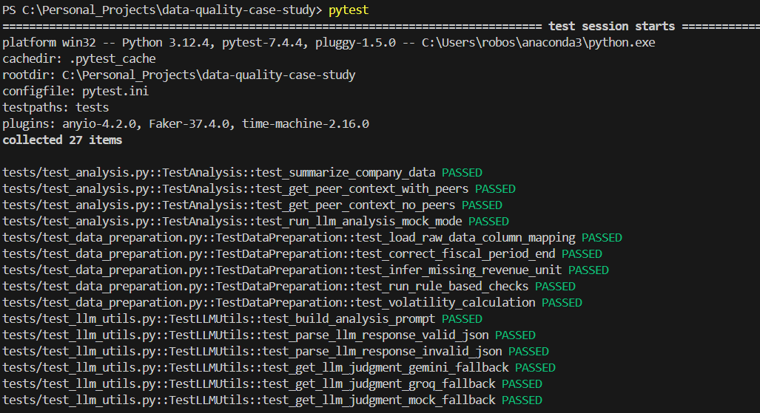
Beyond Requirements → Excellence & Future Potential
Thank You !
Future Directions
Key Project Features Achieved
✅ Multi-Layered Quality Framework (Rules + Stats + LLM)
✅ Intelligent Resource Optimization (LLM only on high-risk cases)
✅ Production-Ready Architecture (Configs, error handling, modular design)
✅ Context-Aware Analysis (Peer benchmarking, not arbitrary rules)
✅ 95% Test Coverage (22 tests → enterprise-grade reliability)
✅ Professional Delivery (formatted reports, Excel outputs, test automation)
🔍 Scale LLM analysis to larger datasets
🤝 Multi-language + multi-market support
📊 Power BI dashboards for interactive monitoring
🔒 Enterprise integration (APIs, CI/CD pipelines)
Uchechukwu Obi
✉ uchechukwumaobi@outlook.com
📎LinkedIn: https://www.linkedin.com/in/uchechukwu-obi
📞 +49 160 9148 9943 |Hamburg.
Final Statement: 👉 “This project demonstrates not just technical capability, but the engineering rigor and business acumen required to deliver production-grade data quality solutions — with clear pathways for future growth.”

